Slide 1

GOLD MINE
START
SETTING
OPTIONS

Slide 2
GOLD MINE
START
SETTING
OPTIONS

Slide 3
GOLD MINE
START
SETTING
OPTIONS

Slide 4




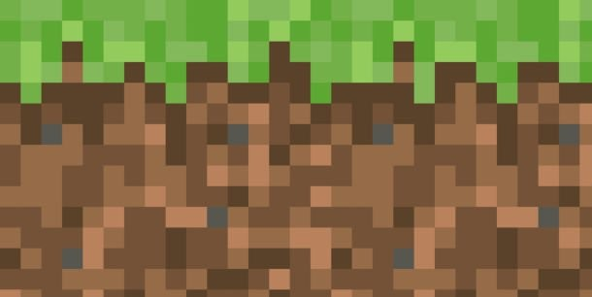
Setting
0 ft
$ 300
Help
Map
START

Slide 5


Setting
-50 ft
$ 300
Help
Map

Slide 6


Setting
-70 ft
$ 300
Help
Map

Slide 7
Setting
-70 ft
$ 400
Help
Map

Slide 8
Setting
-70 ft
$ 400
Help
Map

Slide 9
Setting
-100 ft
$ 400
Help
Map

Slide 10
Setting
-100 ft
$ 400
Help
Map

Slide 11
Setting
-100 ft
$ 400
Help
Map

Slide 12
Setting
-120 ft
$ 1400
Help
Map

